Slide 1
Open Text Reverse KT
Infosys 2019
8^{th August, 2019 Thursday}

Slide 2
Agenda
Application Overview
Application Server Details
Directory Structures
Common Issues
Contact Details

Slide 3
Application overview
SAP Document Access by OpenText. SAP Document Access by OpenText extends the SAP document management capabilities. It allows easy and intuitive display of documents and data according to your business processes, across all used applications, using a secure central repository.
In year 2012 project Started to replace SAR with OpenText application.
Archiving process used in FICO, SD in SAP.
Itella is using Data Archiving & Print List Archiving for their day-to-day business.
In Itella, “Data Archiving” is done currently seven objects:-
COPA1_1000
SD_VBAK
SD_VBRK
FI_DOCUMNT
CO_ITEM
EC_PCA_ITM
IDOC

Slide 4

Application overview
Data Archiving
Quality Archiving – RQ1(ServerID for Quality Archiving)
Developing Archiving – RP1(ServerID for Production Archiving)
How data is Going?
There is one transaction code for SAP system for checking the data.
Tcode – OAC0 (Transaction Code)
(With this Tcode, We have to open either RQ1 and RP1 server and there you will get content repository data details)
SAP State
OpenText

Slide 5
Application overview
Mapping of Content Repositories:
QUA Original Archives[ECC-RQ1] =>T1, T2
PRD Original Archives[ECC-RP1]=> D1
Jobs Naming Convention:
Starting with ARV*

Slide 6
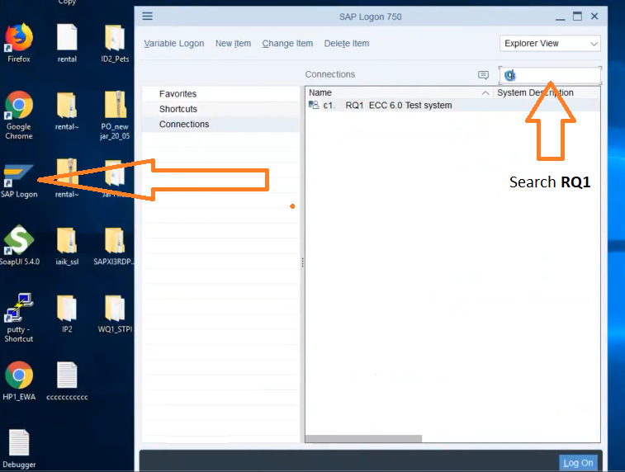
How to Login and Check the Certificates?
Connect the server(RDC)

Slide 7
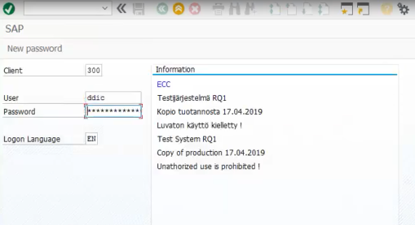
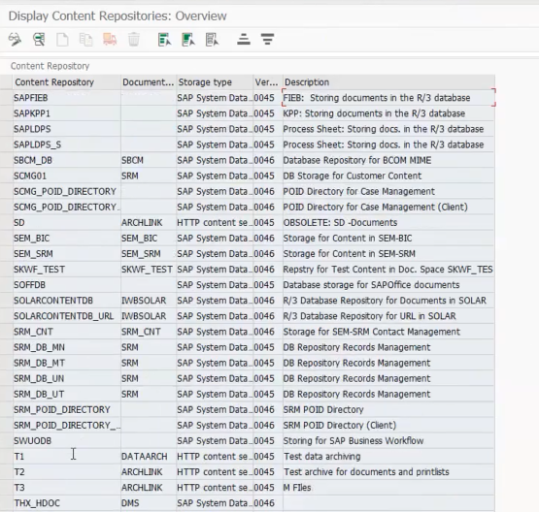
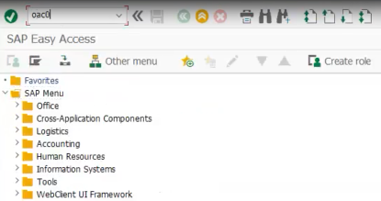
Username and password
Content repositories
Search Tcode: OAC0
T1 Content Repository and Click T1

Slide 8
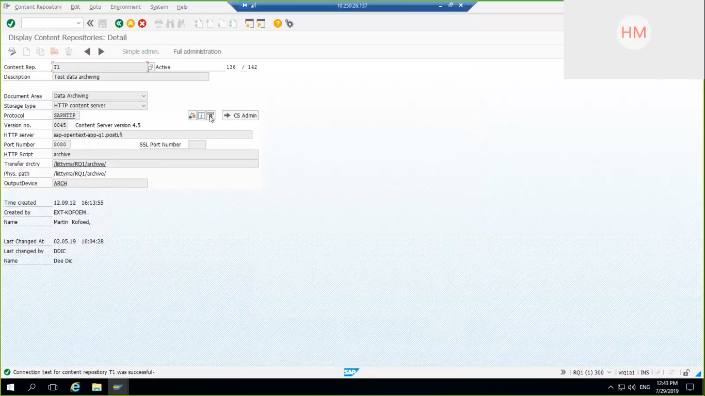
Test Connection
T1 Content Repository
Send Certificate
Success message

Slide 9
Application Server Details
OpenText Application Server details:
Quality:
Production:
Server Name | Server Address | Server IP
AS | sap-opentext-app-q1.posti.fi:8080 | 10.250.5.238
DB | co-opentext-db-tst.posti.fi | 10.250.3.185
Server Name | Server Address | Server IP
AS | sap-opentext-app-p1.posti.fi:8080 | 10.250.3.188
DB | co-opentext-db.posti.fi | 10.250.3.185

Slide 10
Directory Stuctures:
OpenText important Directory Structure details:
SAP Archiving Directory Structures details:[Tcode-OAC0]
Name | Directory Structure
SPAWNERROOT | /data/opentext/LEA/ArchiveServer
BINROOT | /data/opentext/LEA/ArchiveServer
CONFIGROOT | /data/opentext/LEA/ArchiveServer
ECM_LOG_DIR | /data/opentext/LEA/ArchiveServer/log
JAVA_HOME | /usr/lib/jvm/jre1.8.0_181-amd64
ORACLE_HOME | /opt/oracle/app/oracle/product/11g2
Path
RQ1:Physical Path:/liittyma/RQ1/new_archive/
RP1:Physical Path:/liittyma/RP1/new_archive

Slide 11
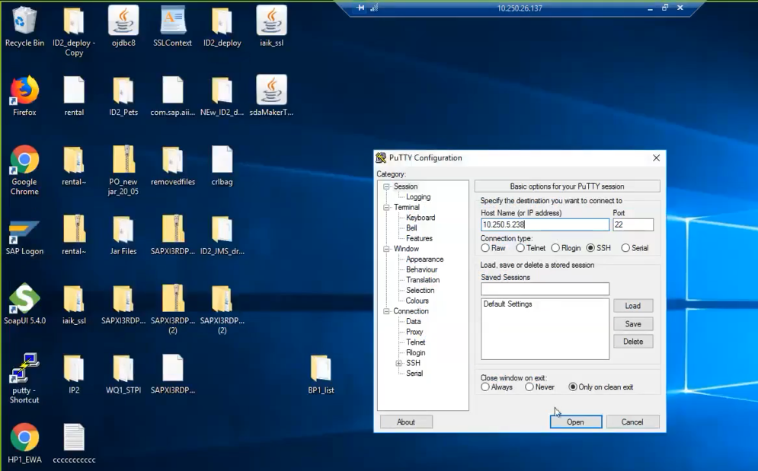
Directory structure view:
Enter Quality System AS
PUTTY

Slide 12
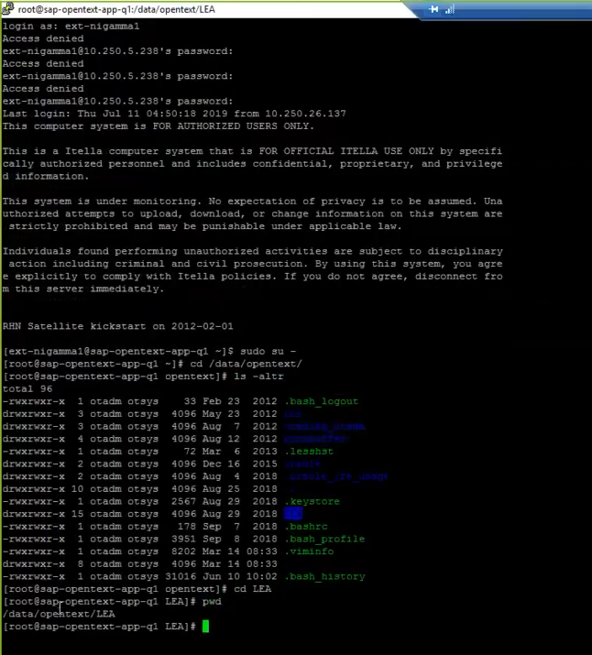
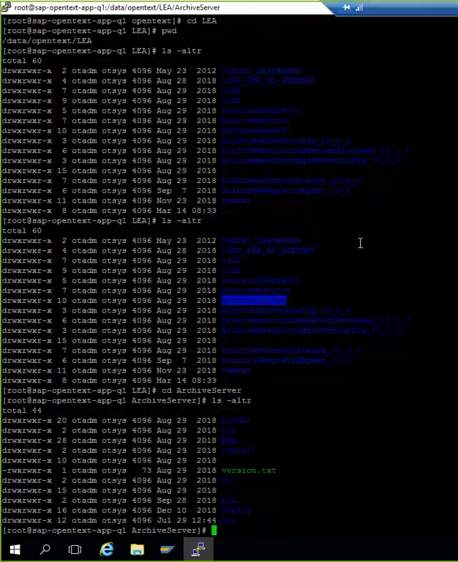
User and Password
Change Directory to LEA
Switch to super user
OpenText Directories
Change directory

Slide 13
Common Issues
Certificates Issue
Server will struct

Slide 14
Contact Details
Solution Manager’s | Name of the person
SAP Archive Solution Manager - ECC | Eija Hangasoja
OpenText Solution Manager | Myntti Petri

Slide 15
☺
Thank You!

